Slide 1
Partner Program

Slide 2
ThingWorx Partner Program
The ThingWorx Partner Program supports the most extensive ecosystem surrounding the Internet of Things.
Primary programs available through the ThingWorx Partner Program include:
ThingWorx Ready
ThingWorx System Integrator
ThingWorx Channel Partner
ThingWorx OEM Program
Additional Supporting Programs
ThingWorx Marketplace
Powered by ThingWorx

Slide 3






























Types of companies and programs
Company Type | Examples | Definition | Potential Programs
Edge Communication Devices | Cert | Manufacturers of edge devices and gateways that can be added to existing products and want to connect to the ThingWorx platform. | ThingWorx Ready Marketplace
Embedded (HW/SW) | Resell | Manufacturers of embedded chips that can be designed into smart connected products that want to connect to the ThingWorx platform. | ThingWorx Ready Marketplace OEM
IoT Platforms |  | Companies looking to offer their own white labeled horizontal IoT platform based on the ThingWorx platform. | OEM
Communication Service Provider (Telcos, MVNOs) | OEM | Service providers including wireless telecommunications, MVNOs, Cable and Satellite providers that wish to offer IoT solutions beyond simple connectivity. | OEM Channel Program Marketplace
Business Systems (Analytics, CRM, Service) | Integration Services | Business systems companies that offer analytics, CRM, and service applications that enhance an IoT complete solution and wish to integrate with ThingWorx. | ThingWorx Ready Marketplace OEM
Systems Integrator | Rev Share | Global or regional system integrators offering services and consulting for IoT projects. May also produce applications that can be certified and published in the marketplace or offer solutions as a service. | System Integrator ThingWorx Ready Powered by ThingWorx Marketplace
Resellers, VARs, VADs | Customer | Regional or vertical focused resellers, VARs, and VADs that resell ThingWorx and possibly other IoT ecosystem products. | Channel Partner Program Marketplace
Solution Providers | Referral | Solutions offered to end customers as a service that were built with the ThingWorx IoT Platform. | Powered by ThingWorx Marketplace
Consultant |  | Companies offering consulting advice and product recommendations around the IoT ecosystem. | Marketplace

Slide 4
Partner Programs Overview
Primary and supporting programs available by Partner Company Type
Program/ Contract | Relationship Type | Comm Device | Embedded (hardware/ software) | Comm Service Provider (MNO, Telco) | Business Systems (Big Data Analytics, CRM, Service) | System Integrator | Reseller | IoT Platform | Solution Provider
ThingWorx Ready Program | Technology Interop/Cert | x | x | x | x
Channel Partner Program | Resell |  |  | x |  |  | x
OEM Program | OEM |  | x | x | x | x |  | x
System Integrator Program | Integration Services |  |  | x |  | x
Marketplace publisher | Rev Share | x | x | x | x | x |  |  | x
Powered By ThingWorx | Customer |  |  | x |  | x |  |  | x

Slide 5

ThingWorx Ready Program
Technology Partner Interoperability and Certification Program
Partners provide hardware, software, or a service such as a sensor, device, software or system that is integrated into the ThingWorx platform and certified by ThingWorx.
Program Benefits:
Participation in the ThingWorx Marketplace
Promotion on ThingWorx.com
Access to ThingWorx Partner Community
Use of ThingWorx Ready logos and website banners
Sponsorship opportunities at ThingWorx events
Invitation to participate in ThingWorx marketing
Collaboration with ThingWorx sales and channel teams
Included ThingWorx Developer license, online Developer Toolbox and Support Community
Program Requirements:
Min one product integrated with ThingWorx and certification verified
Promotion of ThingWorx Ready status on partner’s website
Partner sales and channel teams educated on ThingWorx partnership and positioning
Partner support teams educated on ThingWorx integration
Annual program fee of $3K

Slide 6

ThingWorx System Integrator Program
Global or regional system integrators offering services and consulting for IoT projects. May also produce applications that can be ThingWorx Ready certified and published in the Marketplace or offer Powered by ThingWorx solutions as a service.
SYSTEM INTEGRATOR
Program Level | Program Benefits | Program Requirements
Platinum | Preferred status with ThingWorx sales and channel teams Assigned alliance and marketing managers | Min 5 Trained/Certified Solution Architect (estimated $15K investment) 6+ project implementations
Gold | Enablement activities with ThingWorx sales and channel teams Participation in ThingWorx marketing campaigns | Min 3 Trained/Certified Solution Architect (estimated $10K investment) Min 4 project implementations
Silver | ThingWorx Marketplace Listing Use of ThingWorx logos and website banners Sponsorship opportunities at ThingWorx events | Min 2 Trained/Certified Solution Architect (estimated $5K investment) Min 2 project implementations Joint business plan defined
Registered | Access to ThingWorx Partner Community Included ThingWorx Developer license, online Developer Toolbox and Support Community | Sign ThingWorx Partner Program Agreement and System Integrator Addendum Annual Program fee of $5K
Platinum
Gold
Silver
Registered
SYSTEM INTEGRATOR

Slide 7
ThingWorx Channel Partner Program
Resale program available for resellers, value added resellers, and distributors that resell ThingWorx and possibly other IoT ecosystem products in an approved region or market vertical.
CHANNEL PARTNER
Program Benefits:
Ability to resell the ThingWorx platform in approved geography or market vertical
Discounts according to the ThingWorx Channel Partner volume discount schedule
Included ThingWorx Developer license, online Developer Toolbox and Support Community
Access to complementary sales training, eLearning portal, and discounted technical training
ThingWorx Marketplace company listing
Access to ThingWorx Partner Community
Use of ThingWorx logos and website banners
Sponsorship opportunities at ThingWorx events
Invitation to participate in ThingWorx marketing
Program Requirements:
Qualified Geographic and/or Vertical Market Reach
Signed ThingWorx Partner Program Agreement and Reseller addendum
Ability to provide Level 1 technical support
Partner sales teams educated on ThingWorx partnership and positioning
Min 1 sales engineer complete technical training
Promotion of ThingWorx partner status on partner’s website

Slide 8
ThingWorx OEM Program
OEM program for companies wishing to offer a complete IoT platform private labeled as their own.
Program Benefits:
ThingWorx platform delivery options: private cloud, managed cloud, or on premise solution
Private labeled demos and developer environments
Access to marketing content and user documentation for private labeling
Option to private labeled ThingWorx Marketplace
Access to ThingWorx Developer licenses, online Developer Toolbox and Support Community
Access to complementary sales training, e-learning portal, and discounted technical training
Access to ThingWorx Partner Community
Sponsorship opportunities at ThingWorx events
Program Requirements:
Signed ThingWorx OEM agreement
OEM pricing based on 3 year volume commitment
Provide at a minimum Level 1 technical support
Commitment to sales and technical training for core teams
Commitment to full solution go to market responsibility including sales, marketing, product launch, and support

Slide 9

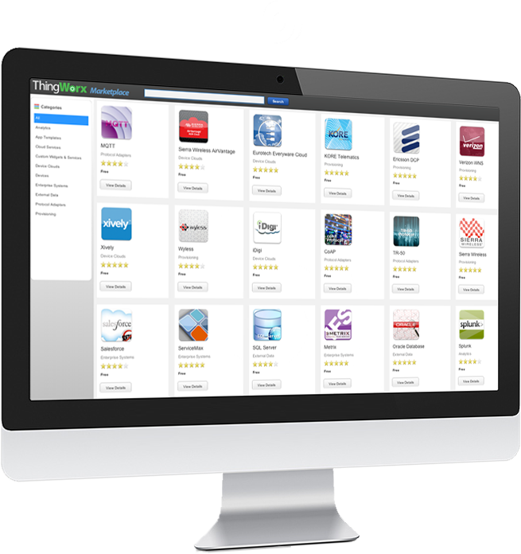
ThingWorx Marketplace
Program Requirements
Qualify your company, product, component or services via the ThingWorx Partner Program
Accept the terms of the ThingWorx Marketplace Publisher Agreement
Provide details required for your listing as well as any downloadable components
The 1st Online Marketplace for the Internet of Things
Marketplace
Program Benefits
Online exchange where partners can build, develop, and market components and applications, and share with ThingWorx customers
Allows instant access to apps or components built by others
Accelerating IoT/M2M adoption through global sharing of IP
Improve IoT solution time-to-market through application “assembly”
Creating additional revenue streams for extensions, apps, devices etc.
Program available to qualified:
ThingWorx Ready technologies
Powered by Solution Providers
System Integrators
Channel Partners

Slide 10
Powered By ThingWorx Solution Providers
Solutions offered to end customers as a service that were built with the ThingWorx IoT Platform.
Powered by
Benefits:
ThingWorx platform tools speed solution development/deployment by 10x
Access to ThingWorx Marketplace to extend/enhance solution with add-ons, extensions, etc.
Ability to market solution in the ThingWorx Marketplace
Access to ThingWorx Partner Community
Use of ThingWorx Powered logos
Sponsorship opportunities at ThingWorx events
Invitation to participate in ThingWorx marketing
Collaboration with ThingWorx sales and channel teams
Requirements:
Signed Powered by ThingWorx agreement
Min 1 validated IoT solution built on ThingWorx
GA launched full solution - complete go to market responsibility including sales, marketing, product launch, and support

Slide 11
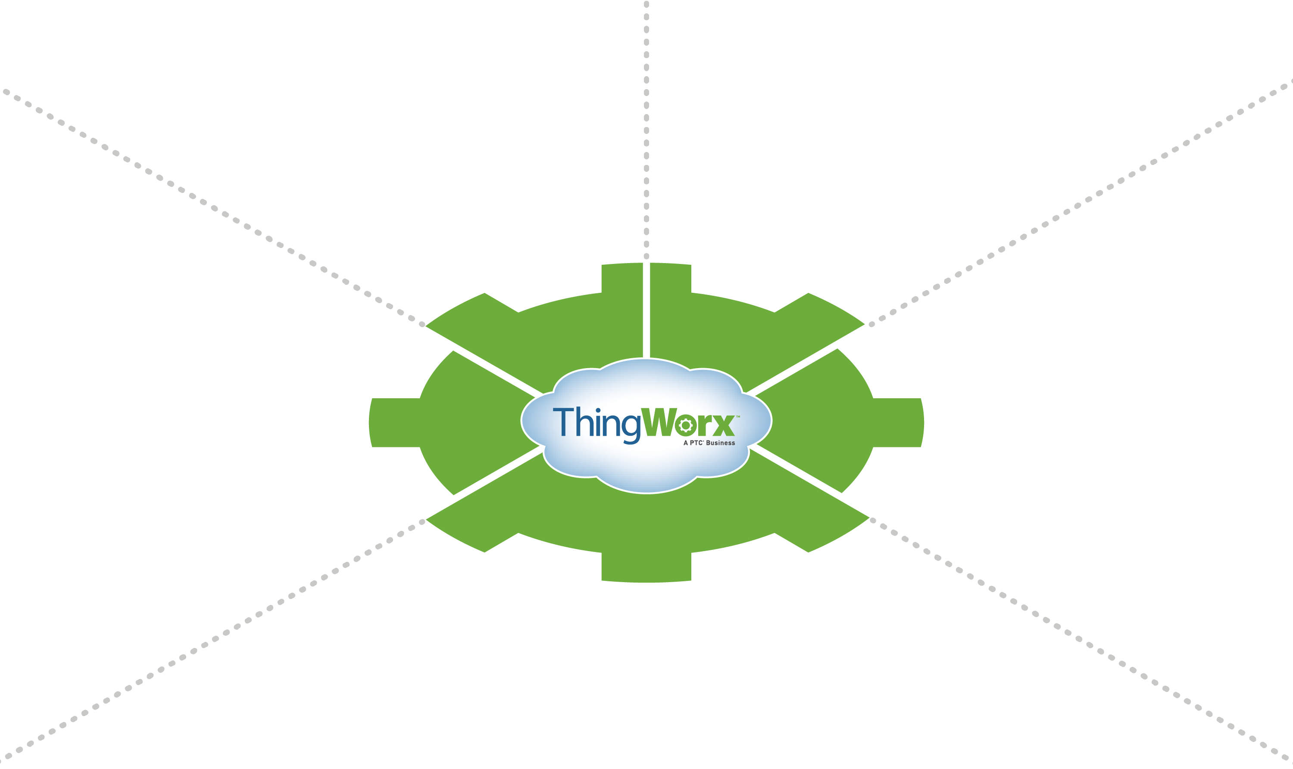

































































ThingWorx IoT Partner Ecosystem
Solution Providers
Systems Integrators
Business Systems/ Analytic Partners
Mobile Network Operators
Edge & Embedded Devices
Notes:
ThingWorx has the most robust partner ecosystem for the Internet of Things. Since the ThingWorx platform is a horizontal play, we rely on third party technology partners to help complete full solutions.
We embrace best of breed partnerships for Edge and Embedded Devices, Business Systems and Analytics, Mobile Network Connectivity, and Solutions Providers who build their solutions integrated with our platform. We also partner with Systems Integrators who have built up IoT practices closely around our IoT platform and who have alignment with our business plans.

Slide 12
Why partner with ThingWorx?
Accelerate IoT Time to Market - Together with ThingWorx
Align with the leading IoT Rapid Application Development and Cloud Platform
Add value by incorporating the ThingWorx ecosystem of "Smart" Application Providers, Analytics, and over 60 ThingWorx Ready Devices
Promote your offerings as part of the ThingWorx Marketplace
Align with the market leading IoT platform and ecosystem
The ThingWorx Partner Program enables ecosystem partners of all types access to the tools and resources required to build an IoT practice.

